Slide 1
Build a Cognitive Serverless Slack App with IBM Cloud Functions & Watson APIs
2hr Hands-on Workshop
Oct 29, 2018 (15h15-17h15)

Slide 2





Meet the Team
Vince Yuen
Eric
Charpentier
Serjik
Dikaleh
Software Developer
IBM Software Adoption
Markham, Canada
IBM Certified IT Specialist (Expert/L2)
IBM Software Adoption
Markham, Canada
Software Developer
IBM Software Adoption
Markham, Canada
IBM Digital Commerce Development
IBM Watson Customer Engagement
Markham, Canada
Manager – Cloud & Watson Solutions
IBM Software Adoption
Markham, Canada
John
Liu
Neil
Delima

Slide 3
Agenda
Introduction
An Introduction to Building Slack Apps
An Overview of IBM Cloud Functions
Hands-On Labs:
Lab 0 – Preparation (15 mins)
Lab 1 – Events (45 mins)
Step 1 – Creating First event (30 mins)
Step 2 – Enhance event to get more info (15 mins)
Lab 2 – Handling Commands (15 mins)
Demo of Watson Assistant (15 min)
Lab 3 – If time permits / On Your Own
Option 1 - Saving data in Cloudant (15 mins)
Option 2 - Watson Assistant Integration (15 mins)
Conclusion - Q&A, Feedback Forms

Slide 4
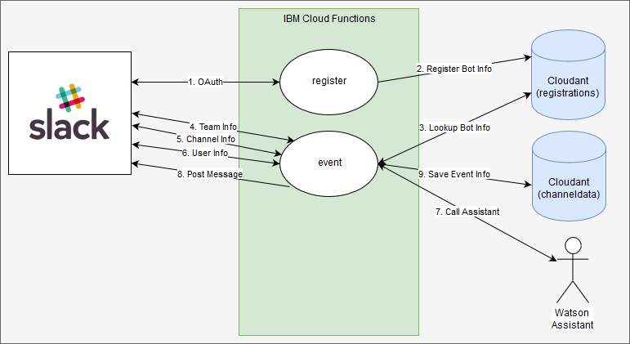
Objective
In this hands-on workshop:
Build a Slack app by using IBM Cloud Functions
Explore other integration possibilities
Demo of Watson Assistant integration via a Slack chatbot that provides cognitive services within a demonstrated knowledge domain

Slide 5
Introduction to Slack and Slack Apps
Searchable Log of All Conversation and Knowledge
Communication medium with numerous options for users to share information through workspaces
Slack provides a rich set of APIs that can be used to extend its core functionality via custom Slack apps
Customize functionality for your own workspace or share with others
Businesses can benefit from analyzing conversations
via chatbots, extension commands, integration with external services
context or sentiment based analysis for various potential actions

Slide 6
Introduction to IBM Cloud Functions
IBM’s serverless FaaS (Functions as a Service), event-driven cloud computing platform
Application logic (actions) embedded in small units of code often referred to as functions are executed in response to events (triggers)
No provisioning and server management
Auto scaling, pay for what you use, per second billing, management, monitoring, logging and debugging
Use Cases:
Data-driven applications, timers, APIs , microservices, webhooks, web applications, mobile back-ends, IoT and streaming Data, data processing pipelines
Chatbots and messaging
Notes:
References:
[1] http://openwhisk.incubator.apache.org/serverless.html
[2] https://developer.ibm.com/openwhisk/2016/02/22/microservices-without-the-hassle-of-infrastructure/
[3] http://serverlessconf.io/
[4] https://martinfowler.com/articles/serverless.html
[5] https://cloud.google.com/functions/
[6] https://console.bluemix.net/openwhisk/
[7] https://github.com/apache/incubator-openwhisk/blob/master/docs/use_cases.md
[8] https://console.bluemix.net/docs/openwhisk/openwhisk_use_cases.html#openwhisk_common_use_cases

Slide 7
IBM Cloud Functions
Actions
Code encapsulated in a function whose signature conforms to a specific format and executes in response to a trigger or event.
JavaScript, Swift, PHP or Python functions, Java methods and executable code packaged in Docker containers.
Input to and results from actions are Key (String) Value (JSON) Pairs
Web Actions
Respond to HTTP requests with HTTP headers, a status and body
Notes:
References:
[1] https://console.bluemix.net/docs/openwhisk/openwhisk_actions.html#openwhisk_actions
[2] https://github.com/apache/incubator-openwhisk/blob/master/docs/actions.md
[3] https://console.bluemix.net/docs/openwhisk/openwhisk_webactions.html#openwhisk_webactions

Slide 8
IBM Cloud Functions
Sequences
Chain together actions so that the output from one action serves as input to the next
Triggers
A named channel for a class of events (eg. an email received)
Feeds
Can be used to configure an event source to trigger events
Rules
Associates a Trigger with an Action
Packages
A bundle of Actions and Feeds that can be shared
Bind parameters and environment variable to a package to make them available in actions
Notes:
References:
[1] https://github.com/apache/incubator-openwhisk/blob/master/docs/triggers_rules.md
[2] https://github.com/apache/incubator-openwhisk/blob/master/docs/feeds.md
[3] https://console.bluemix.net/docs/openwhisk/openwhisk_triggers_rules.html#openwhisk_triggers
[4] https://console.bluemix.net/docs/openwhisk/openwhisk_packages.html#openwhisk_packages
[5] https://console.bluemix.net/docs/openwhisk/openwhisk_catalog.html#openwhisk_ecosystem
[6] https://github.com/apache/incubator-openwhisk/blob/master/docs/packages.md

Slide 9
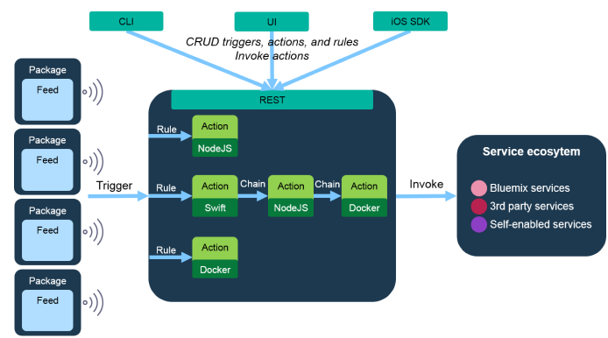
IBM Cloud Functions
IBM Cloud cmd line: ibmcloud
REST API curl -u USERNAME:PASSWORD https://openwhisk.ng.bluemix.net/api/v1/namespaces/whisk.system/packages
Notes:
References:
[1] https://github.com/apache/incubator-openwhisk/blob/master/docs/about.md

Slide 10
Troubleshooting
Monitoring and Debugging
Use the IBM Cloud Functions Dashboard
View activation results and logs with: ibmcloud wsk activation (list, get, results, poll, …)
Notes:
References:
[1] https://console.bluemix.net/docs/openwhisk/openwhisk_monitoring.html#monitor-activity-with-the-cloud-functions-dashboard

Slide 11
Workshop Pre-requisites
IBM Cloud - username and password
Slack Workspace - name, username and password
Before you begin…
On the virtual machine (VM):
1. Connect to the virtual machine with the credentials provided in class
2. Go to the cascon directory
cd cascon
3. Run the following command to clone the Git repository
./gitclone.sh
OR in your own environment:
1. Clone the repository:
git clone https://github.com/cloud-coder/cascon2018-slackapp.git

Slide 12
Lab 0 Preparation (15 mins)
Creating the Slack app
Login to IBM Cloud
Review Files and Structure
Create Bluemix Cloudant service

Slide 13
Lab 1 Step 1 – Creating an Event (30 mins)
Create the Cloud Function
Deploy the Cloud Functions as web actions
Add a slack bot, a slack event and register the Cloud Function with the event
Set the callback URL for authentication
Add the app to your team (workspace)

Slide 14
Lab 1 Step 2 – Getting more Info (15 mins)
Enhance the event created in step 1
Use Slack web API to get more info
Tell me more about a user, channel, or team
Personalize the response
Modify the code to reply back with the real user name

Slide 15
Lab 2 Handling Commands (15 mins)
Create a function that handles a command coming from Slack
Call the Weather API
Respond back with the current temperature and weather info

Slide 16
Demo IBM Watson Assistant (15 mins)
Enhance the IBM function to call the Watson Assistant API to have a conversation in Slack
Predefined knowledge domain: Driving

Slide 17
Lab 3 - Optional < If time permits / On your own >
Lab 3 - Option 1: Saving data into Cloudant (15 mins)
Continuing from Lab 1 step 2:
you will create and connect to the channeldata database
Lab 3 - Option 2: Watson Integration (15 mins)
Behind the demo:
explore how to enhance the IBM function to call the Watson Assistant API

Slide 18
References
http://openwhisk.incubator.apache.org/serverless.html
https://developer.ibm.com/openwhisk/2016/02/22/microservices-without-the-hassle-of-infrastructure/
http://serverlessconf.io/
https://martinfowler.com/articles/serverless.html
https://console.bluemix.net/openwhisk/
https://github.com/apache/incubator-openwhisk/blob/master/docs
https://console.bluemix.net/docs/openwhisk/

Slide 19
References
https://console.bluemix.net/docs/openwhisk/openwhisk_use_cases.html#openwhisk_common_use_cases
https://console.bluemix.net/docs/openwhisk/openwhisk_actions.html#openwhisk_actions
https://github.com/apache/incubator-openwhisk/blob/master/docs/actions.md
https://console.bluemix.net/docs/openwhisk/openwhisk_webactions.html#openwhisk_webactions
https://github.com/apache/incubator-openwhisk/blob/master/docs/triggers_rules.md
https://github.com/apache/incubator-openwhisk/blob/master/docs/feeds.md
https://console.bluemix.net/docs/openwhisk/openwhisk_triggers_rules.html#openwhisk_triggers
https://console.bluemix.net/docs/openwhisk/openwhisk_packages.html#openwhisk_packages
https://console.bluemix.net/docs/openwhisk/openwhisk_catalog.html#openwhisk_ecosystem
https://console.bluemix.net/docs/openwhisk/openwhisk_monitoring.html#monitor-activity-with-the-cloud-functions-dashboard
https://console.bluemix.net/docs/openwhisk/openwhisk_apigateway.html#openwhisk_apigateway
https://console.bluemix.net/docs/apis/management/index.html#index
https://console.bluemix.net/docs/openwhisk/openwhisk_apigateway.html#openwhisk_apigateway
https://console.bluemix.net/docs/apis/management/manage_openwhisk_apis.html#manage_openwhisk_apis

Slide 20
Backup Slides

Slide 21
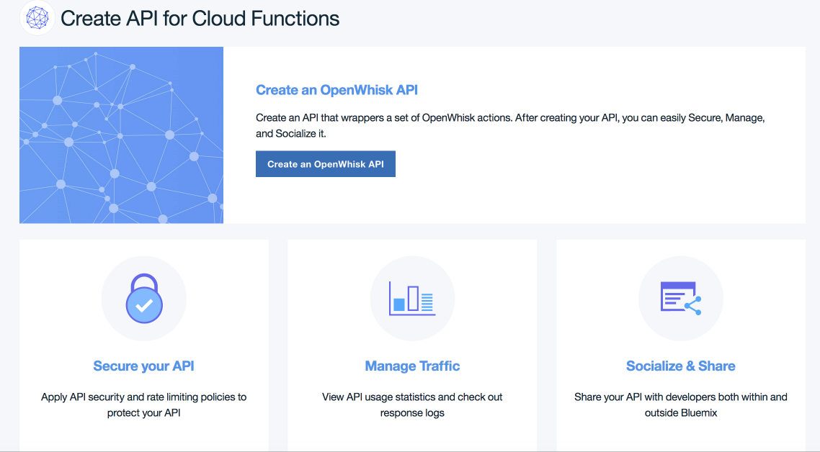
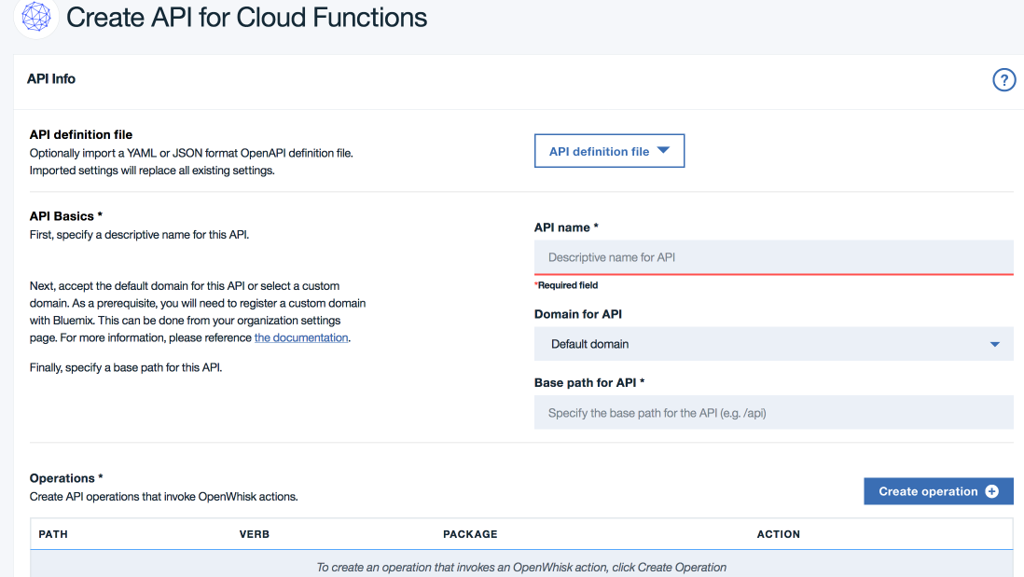
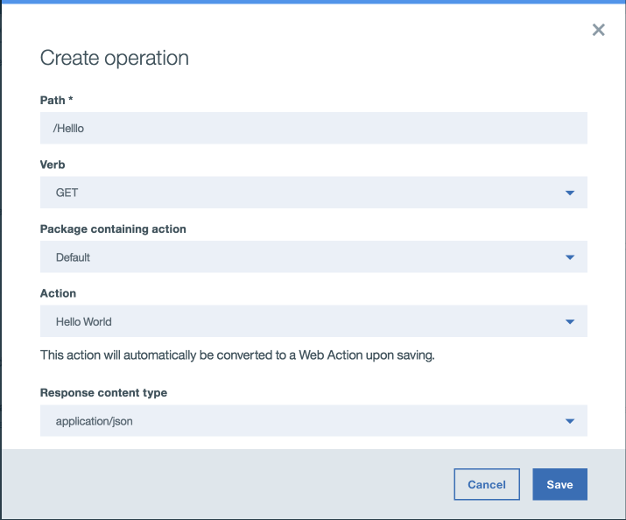
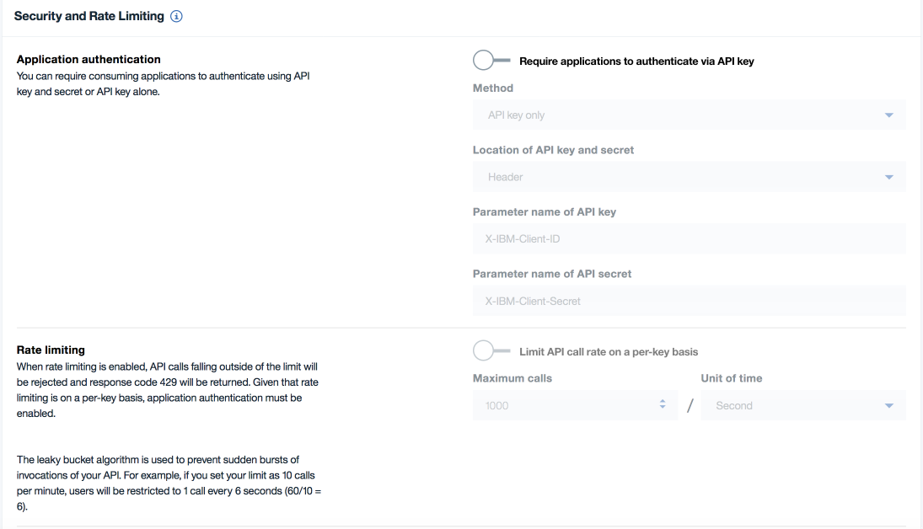
An Overview of IBM Cloud Functions
API Gateway: API Management via the Cloud Functions Dashboard
API Management via the Command Line Interface
Get and Set the API Host and Auth Key:
Create an API for an action: ibmcloud wsk api create ...
List APIs
Export APIs to Swagger JSON which can be later used to re-create the APIs
Delete All APIs
Notes:
References:
[1] https://console.bluemix.net/docs/openwhisk/openwhisk_apigateway.html#openwhisk_apigateway
[2] https://console.bluemix.net/docs/apis/management/index.html#index
[3] https://console.bluemix.net/docs/openwhisk/openwhisk_apigateway.html#openwhisk_apigateway
[4] https://console.bluemix.net/docs/apis/management/manage_openwhisk_apis.html#manage_openwhisk_apis

Slide 22
An Overview of IBM Cloud Functions
IBM’s Serverless / Functions as a Service, event driven cloud compute platform.
Application logic (actions or functions) embedded in small units of code often referred to as functions are executed in response to events (triggers).
No provisioning and server management
Auto scaling
Pay for what you use
Per second billing
Integration with IBM Cloud Services: MessageHub, Cloudant, Watson, …
Management, Monitoring, Logging and Debugging
Use Cases:
Event Driven Applications(Timers, Data driven events,...)
APIs , Microservices and WebHooks
Web Applications & Mobile back-ends
Chatbots and Messaging
IoT and Streaming Data
Data Processing Pipelines
Notes:
References:
[1] http://openwhisk.incubator.apache.org/serverless.html
[2] https://developer.ibm.com/openwhisk/2016/02/22/microservices-without-the-hassle-of-infrastructure/
[3] http://serverlessconf.io/
[4] https://martinfowler.com/articles/serverless.html
[5] https://cloud.google.com/functions/
[6] https://console.bluemix.net/openwhisk/
[7] https://github.com/apache/incubator-openwhisk/blob/master/docs/use_cases.md
[8] https://console.bluemix.net/docs/openwhisk/openwhisk_use_cases.html#openwhisk_common_use_cases

Slide 23
An Overview of IBM Cloud Functions
Sequences:
Sequences chain together actions so that the the output from one action serves as input to the next
Triggers:
A named channel for a class of events ex. an email received
Can be fired (activated) by using a dictionary of key-value pairs.
Can be fired explicitly by a user or on behalf of a user by an external event source.
Feeds:
Can be used to configure an event source to trigger events ex. a Cloudant feed that fires events when a database is changed
Three patterns for Feeds: WebHooks, Polling and Connections
Rules:
Associates a Trigger with an Action
A single trigger can invoke multiple actions (with multiple rules) and multiple triggers can invoke a single Action
Packages:
A bundle of Actions and Feeds that can be shared
Built-in packages available in the /whisk.system namespace ex. System, Cloudant, Weather, etc,
Bind parameters and environment variable to a package to make them available in actions
Notes:
References:
[1] https://github.com/apache/incubator-openwhisk/blob/master/docs/triggers_rules.md
[2] https://github.com/apache/incubator-openwhisk/blob/master/docs/feeds.md
[3] https://console.bluemix.net/docs/openwhisk/openwhisk_triggers_rules.html#openwhisk_triggers
[4] https://console.bluemix.net/docs/openwhisk/openwhisk_packages.html#openwhisk_packages
[5] https://console.bluemix.net/docs/openwhisk/openwhisk_catalog.html#openwhisk_ecosystem
[6] https://github.com/apache/incubator-openwhisk/blob/master/docs/packages.md

